Slide 1
The Sudoku Project
industrial training at the valley bootcamp, Bangalore

Slide 2
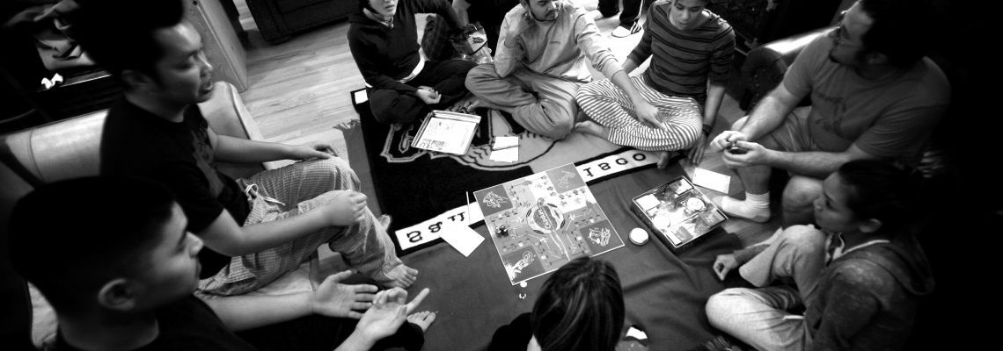
The Valley Bootcamp, Bangalore
Highest rated bootcamp in Bangalore
An intensive coding school, teaches you to code like a pro.
We value Study, Ethics & Environment as it helps in creating a Creative Buzz

Slide 3

C++: Data structures and algorithms
C++ is a general-purpose programming language created by Bjarne Stroustrup as an extension of the C programming language
A data structure is a particular way of organizing data in a computer so that it can be used effectively
An algorithm is a procedure or formula for solving a problem, based on conducting a sequence of specified actions

Slide 4
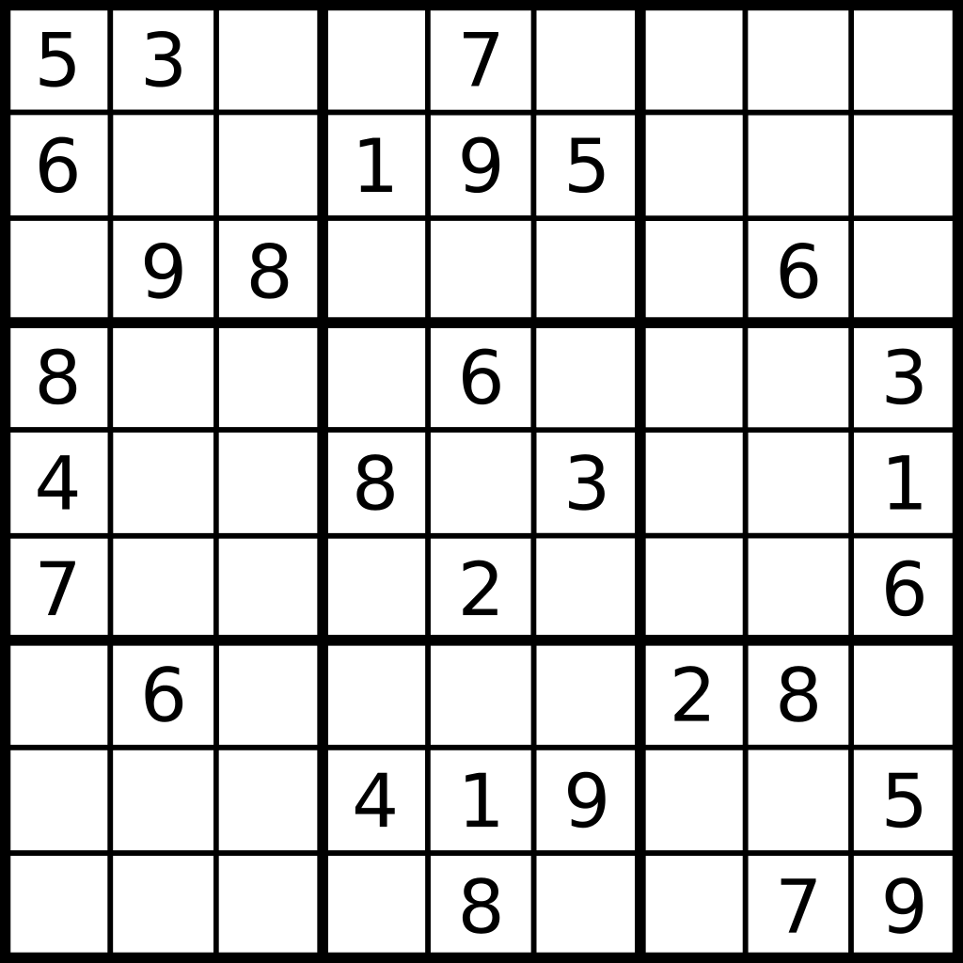
The Sudoku Project
Sudoku is a logic-based, combinatorial number-placement puzzle game
The objective is to fill a 9×9 grid with digits so that each column, each row, and each of the nine 3×3 sub grids that compose the grid contain all of the digits from 1 to 9

Slide 5
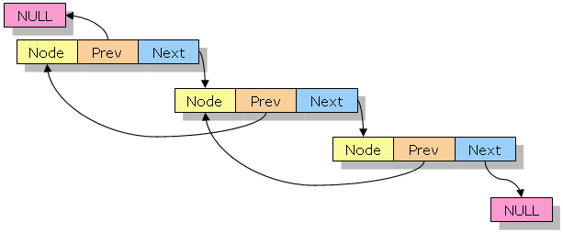
The Sudoku Project
This rendition of the classic game of Sudoku is made with C++
Data structure used is Doubly Linked List

Slide 6
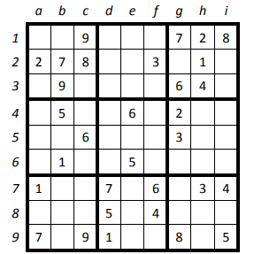
Problem statement
Given a partially filled 9×9 2D array (grid[9][9]), the goal is to assign digits (from 1 to 9) to the empty cells so that every row, column, and sub grid of size 3×3 contains exactly one instance of the digits from 1 to 9.

Slide 7
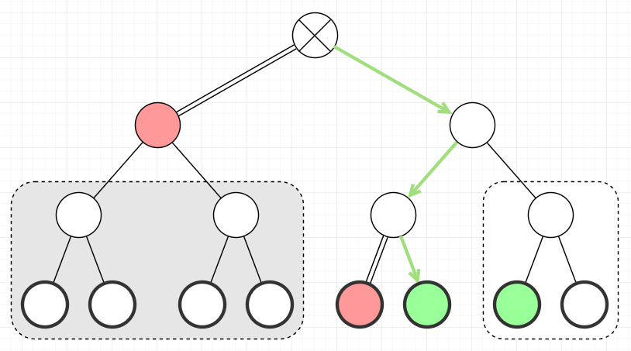
BackTracking Algorithm
We can solve Sudoku by one by one assigning numbers to empty cells
Before assigning a number, we check whether it is safe to assign
After checking for safety, we assign the number, and recursively check whether this assignment leads to a solution or not
If the assignment doesn’t lead to a solution, then we try the next number for the current empty cell

Slide 8
Flow of the program
main()
It is the entry point of any C++ program
read_Sudoku()
This function reads the Sudoku entered by the user
It gets the value from the user and stores it in a matrix
solve_Sudoku()
This function solves the given Sudoku using doubly linked list
print_Sudoku()
It is the main function responsible for the execution of rest of the functions
It uses another key function: check_safety() & attach_node()
After solving the Sudoku, this function prints out the result in a 9×9 matrix

Slide 9
Other functions used
Check_Safety() – This function makes sure that no value is repeated in the linked list. It raises the flag and the concerned number is discarded
Attach_Node() – If no flag is raised by the Check_Safety function, then attach_Node() function is executed which adds the concerned number to the linked list
Counter – Counter is a variable that keeps track of how many times Check_Safety() function is executed

Slide 10
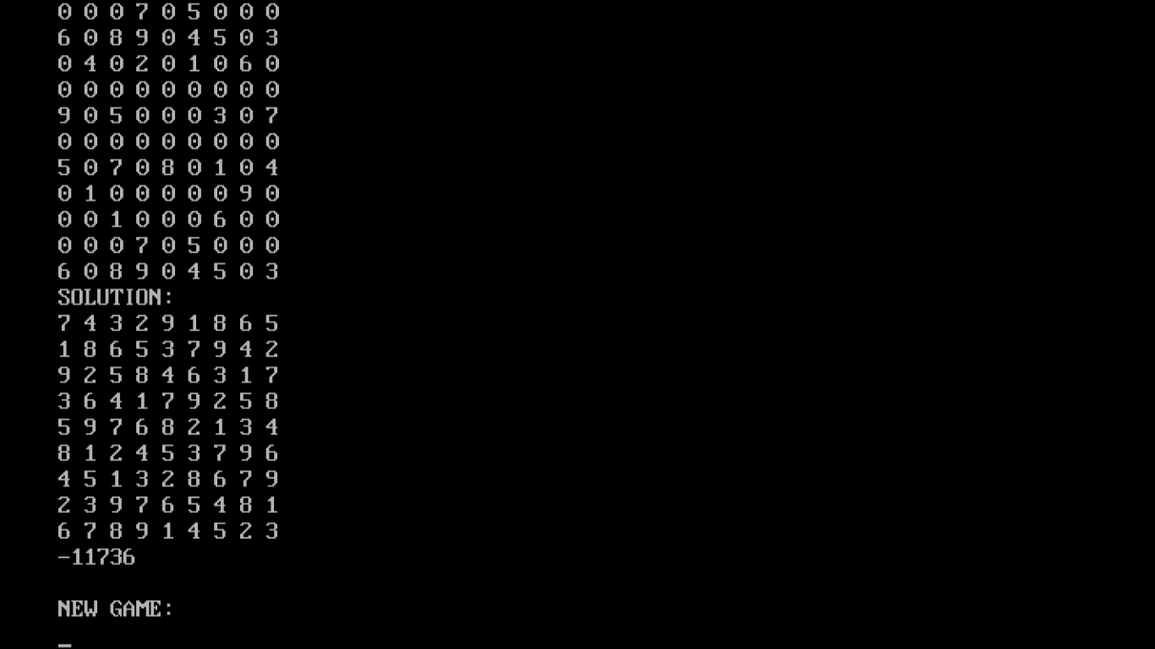
The Sudoku project
Input
Output

Slide 11
conclusion
The algorithm designed is found to be accurate and returned true for 93.9% of test cases
The proposed algorithm is able to solve such puzzles with any level of difficulties in a short period of time (less than one second)
Further research needs to be carried out in order to optimize the algorithm

Slide 12
Thank You
By Prateek Sharma

